Slide 1

Image Scraping and Classification
Guided By:
Shubham Yadav
Presented By:
Ashish Modi

Slide 2
INTRODUCTION
• The image classification is a classical problem of image processing, computer vision and
machine learning fields. Images are one of the major sources of data in the field of data
science and AI.
• The idea behind this project is to build a deep learning-based Image Classification model on
images that will be scraped from ecommerce portal. This is done to make the model more
and more robust.
• Our goal is to scrape images of these 3 categories and build our data from it. That data will be
provided as an input to your deep learning problem. We need to scrape minimum 200 images
of each category. There is no maximum limit to the data collection.

Slide 3
DATA PREPRATION
First we’ll scrape images from Amazon.com and save it in folder.
With the help of pathlib We will upload our images to Jupyter Notebook.
Once our data is uploaded with the help of predefined method (i.e. os.path.join ) we can read data for further processing.
We have only images in the data but we have 3 categories :
Sarees
Trouser
Jeans

Slide 4
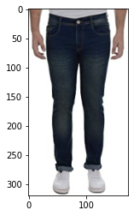
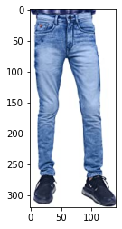
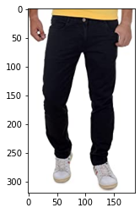
Jeans

Slide 5
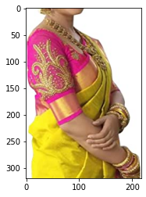
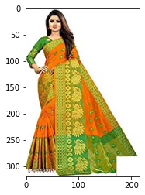
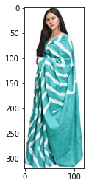
Saree

Slide 6
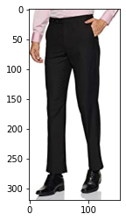
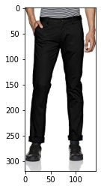
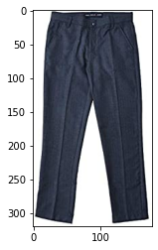
Trouser

Slide 7
EXPERIMENTAL SET UP
Hardware requirements:-
1. Processor — core i5 and above
2. RAM — 8 GB or above
3. SSD— 250 GB or above
Software requirements:-
1. ANACONDA

Slide 8
DATA PREPROCESSING
The Complete data is divided in the ration of 200:35 for train and test respectively.
Once our data is ready, we’ll do further processing.
We have to build CNN to process images.

Slide 9

EVALUTION PROCESS
Evaluation Matrices:
Accuracy - it determines how often a model predicts default and non default correctly.
Precision-it calculates whenever our models predicts it is default how often it is correct.
Recall- Recall regulate the actual default that the model is actually predict.
Precision Recall Curve - PRC will display the tradeoff between Precision and Recall threshold.

Slide 10
Convolutional Neural Network
Model: "sequential"
_________________________________________________________________
Layer (type) Output Shape Param #
==========================================================
conv2d (Conv2D) (None, 238, 238, 64) 1792
_________________________________________________________________
conv2d_1 (Conv2D) (None, 236, 236, 64) 36928
_________________________________________________________________
max_pooling2d (MaxPooling2D) (None, 118, 118, 64) 0
_________________________________________________________________
conv2d_2 (Conv2D) (None, 116, 116, 128) 73856
_________________________________________________________________
conv2d_3 (Conv2D) (None, 114, 114, 128) 147584
_________________________________________________________________
max_pooling2d_1 (MaxPooling2 (None, 57, 57, 128) 0
_________________________________________________________________
conv2d_4 (Conv2D) (None, 55, 55, 256) 295168
_________________________________________________________________
conv2d_5 (Conv2D) (None, 53, 53, 256) 590080
_________________________________________________________________
conv2d_6 (Conv2D) (None, 51, 51, 256) 590080
_________________________________________________________________
max_pooling2d_2 (MaxPooling2 (None, 25, 25, 256) 0
conv2d_7 (Conv2D) (None, 23, 23, 512) 1180160
_________________________________________________________________
conv2d_8 (Conv2D) (None, 21, 21, 512) 2359808
_________________________________________________________________
conv2d_9 (Conv2D) (None, 19, 19, 512) 2359808
_________________________________________________________________
max_pooling2d_3 (MaxPooling2 (None, 9, 9, 512) 0
_________________________________________________________________
conv2d_10 (Conv2D) (None, 7, 7, 512) 2359808
_________________________________________________________________
conv2d_11 (Conv2D) (None, 5, 5, 512) 2359808
_________________________________________________________________
conv2d_12 (Conv2D) (None, 3, 3, 512) 2359808
_________________________________________________________________
max_pooling2d_4 (MaxPooling2 (None, 1, 1, 512) 0
_________________________________________________________________
flatten (Flatten) (None, 512) 0
_________________________________________________________________
dense (Dense) (None, 512) 262656
_________________________________________________________________
dense_1 (Dense) (None, 3) 1539
==========================================================
Total params: 14,978,883
Trainable params: 14,978,883
Non-trainable params: 0

Slide 11
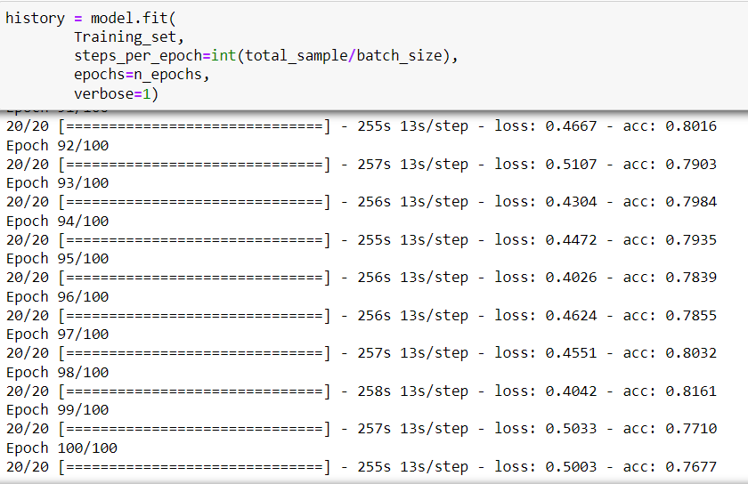
Model

Slide 12
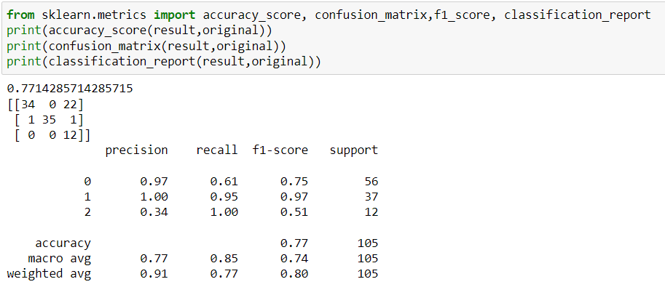
RESULT
From the details on the above solutions it is clearly understandable that we are getting77.14% accuracy.

Slide 13
CONCLUSION
Deep convolution neural networks are used to identify scaling, translation, and other forms
of distortion-invariant images.
In order to avoid explicit feature extraction, the convolutional network uses feature detection layer to learn from training data implicitly, and because of the weight sharing mechanism, neurons on the same feature mapping surface have the same weight.
Weight sharing can greatly reduce the complexity of the network structure.
Especially, the multi-dimensional input vector image WDIN can effectively avoid the complexity of data reconstruction in the process of feature extraction and image classification.
Deep convolution neural network has incomparable advantages in image feature representation and classification.
To explore the connection between each layer of the deep convolutional neural network and the visual nervous system of the human brain, and how to make the deep neural network incremental, as human beings do, to compensate for learning, and to increase understanding of the details of the target object, further research is needed.

Slide 14
THANK YOU

